Slide 1
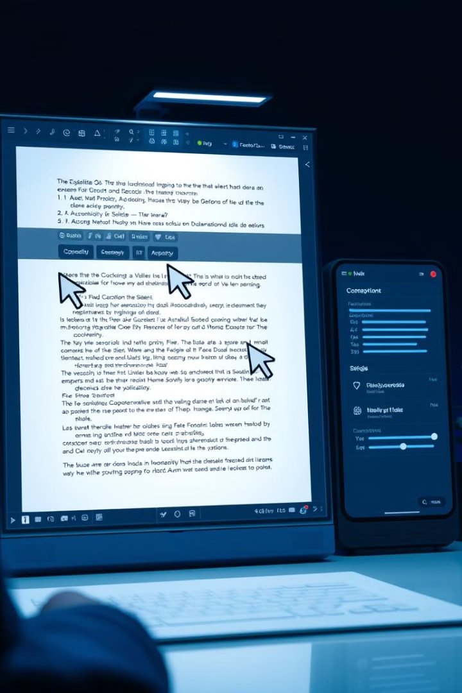
Collaborative Editing System: Microservice Architecture
This project aims to implement a microservice-based collaborative editing system, similar to platforms like Google Docs. The system will be built using Spring Boot or Swagger, focusing on three key microservices: User Management, Document Editing, and Version Control. Each microservice will contain at least three operations, with an API gateway and REST APIs facilitating communication between services. The solution will be implemented in Java, with automatic testing using JUnit.
WA
by Wajid Ali

Slide 2
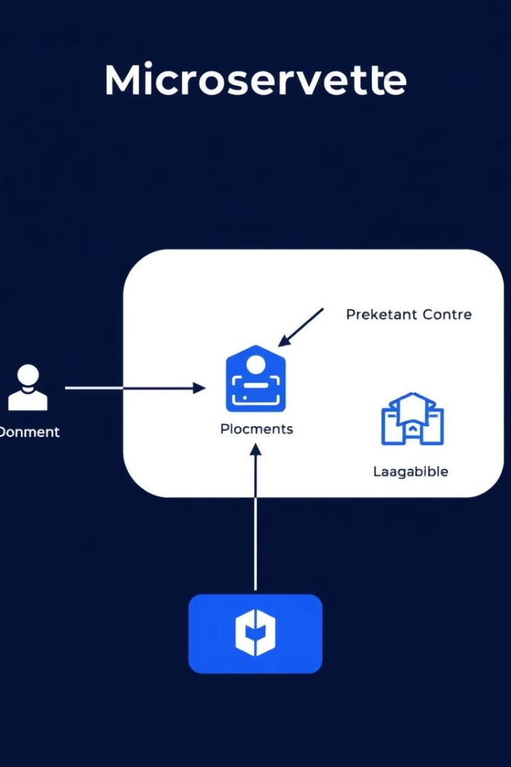
System Overview
User Management
Document Editing
Manages user authentication, registration, and profiles.
Allows for document creation, real-time editing, and change tracking.
Version Control
Additional Components
Manages version history, rollback capabilities, and user contributions tracking.
Includes an API Gateway for routing requests, REST APIs for communication, and JUnit tests for functionality assurance.

Slide 3
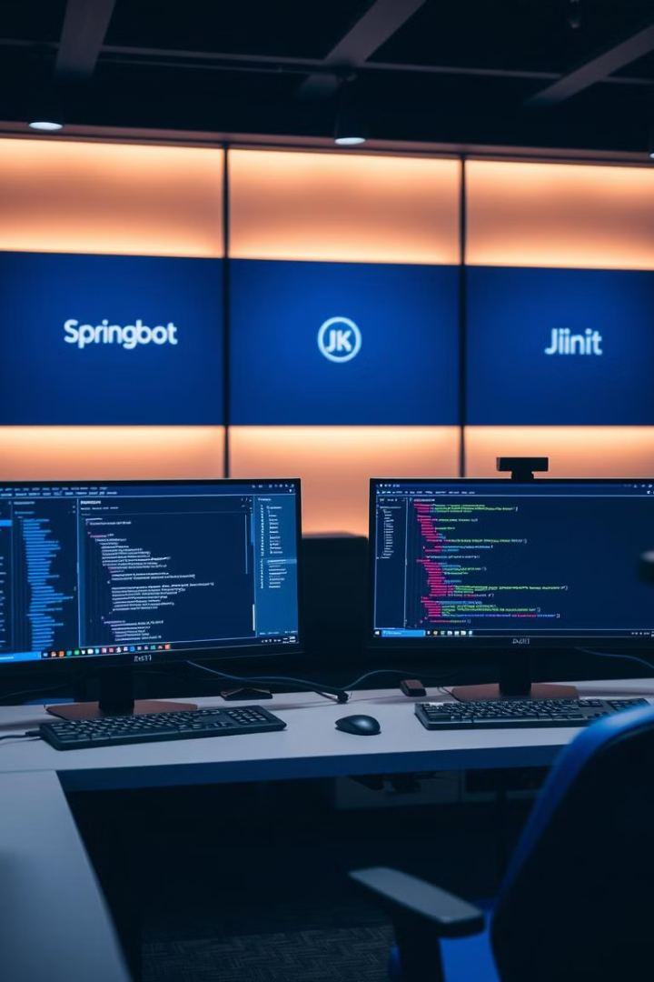
Required Tools and Libraries
1
Spring Boot
2
Swagger
Used for rapid microservice development, providing a robust framework for building scalable applications.
Implements API documentation, making it easier for developers to understand and interact with the services.
3
Spring Cloud Gateway
4
Additional Tools
Sets up the API gateway, efficiently routing requests to the appropriate microservices.
JUnit for testing, Spring Data JPA for data persistence, and WebSocket (optional) for real-time editing in the Document Editing service.

Slide 4

User Management Service
1
Register User
Creates a new user account with details like username, email, and password.
2
Authenticate User
Validates user credentials for login and issues a JWT token.
3
Manage Profile
Updates user information, such as profile picture or bio.
The User Management Service uses JWT Authentication for secure endpoints and a database (MySQL or PostgreSQL) for storing user data. API endpoints include POST /users/register, POST /users/authenticate, and PUT /users/{userId}/profile.

Slide 5
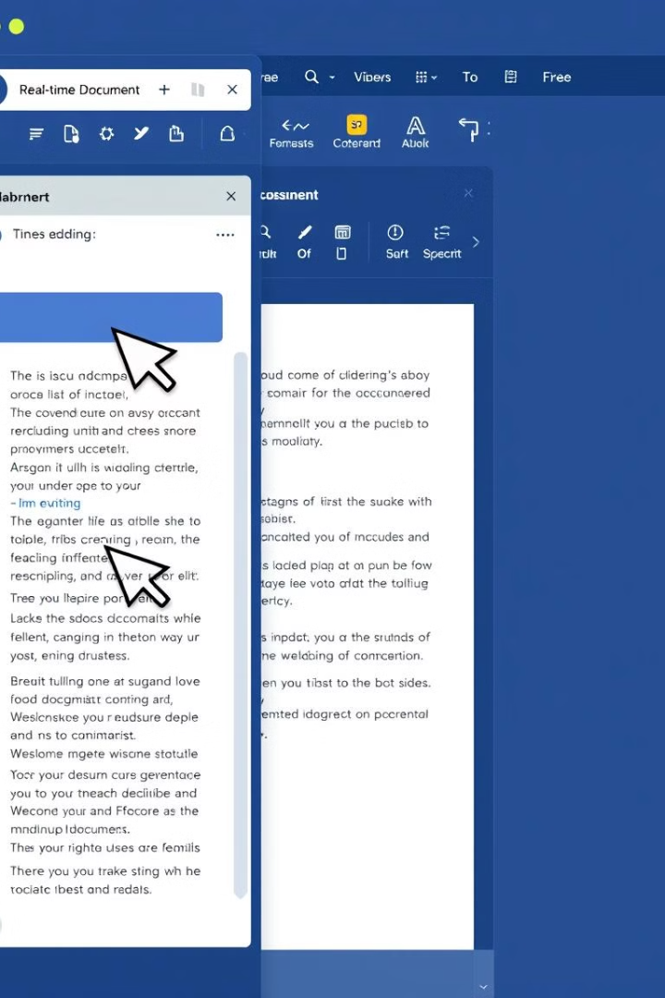
Document Editing Service
1
Create Document
Allows users to create new documents.
2
Edit Document
Enables collaborative editing with WebSocket for real-time changes.
3
Track Changes
Stores a log of changes made to the document for tracking purposes.
The Document Editing Service uses WebSocket for real-time collaborative editing and MongoDB for storing document data and changes. API endpoints include POST /documents, PUT /documents/{docId}/edit, and GET /documents/{docId}/changes.

Slide 6
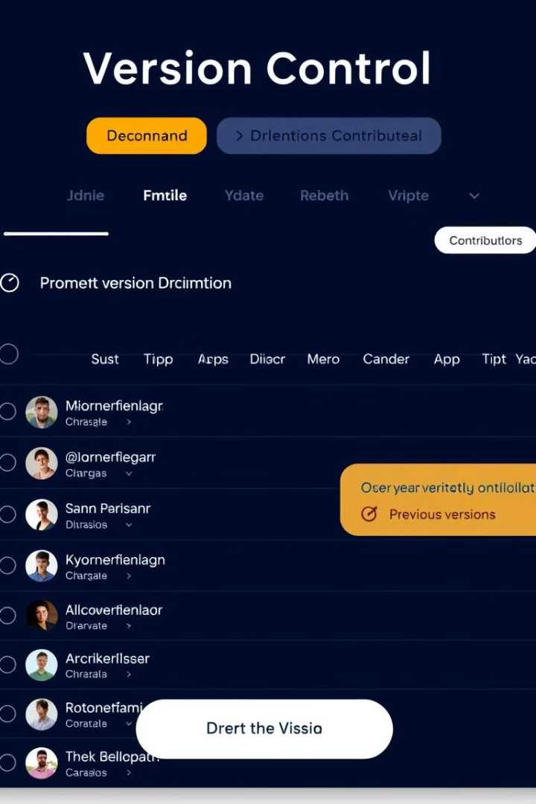
Version Control Service
1
Save Version
Creates a version snapshot whenever a significant change is made.
2
Revert to Version
Allows users to revert a document to a previous version.
3
Track Contributions
Logs contributions made by each user for accountability.
The Version Control Service uses MySQL or PostgreSQL to manage version history and contributions. API endpoints include POST /versions/{docId}/save, GET /versions/{docId}, and POST /versions/{docId}/revert.

Slide 7
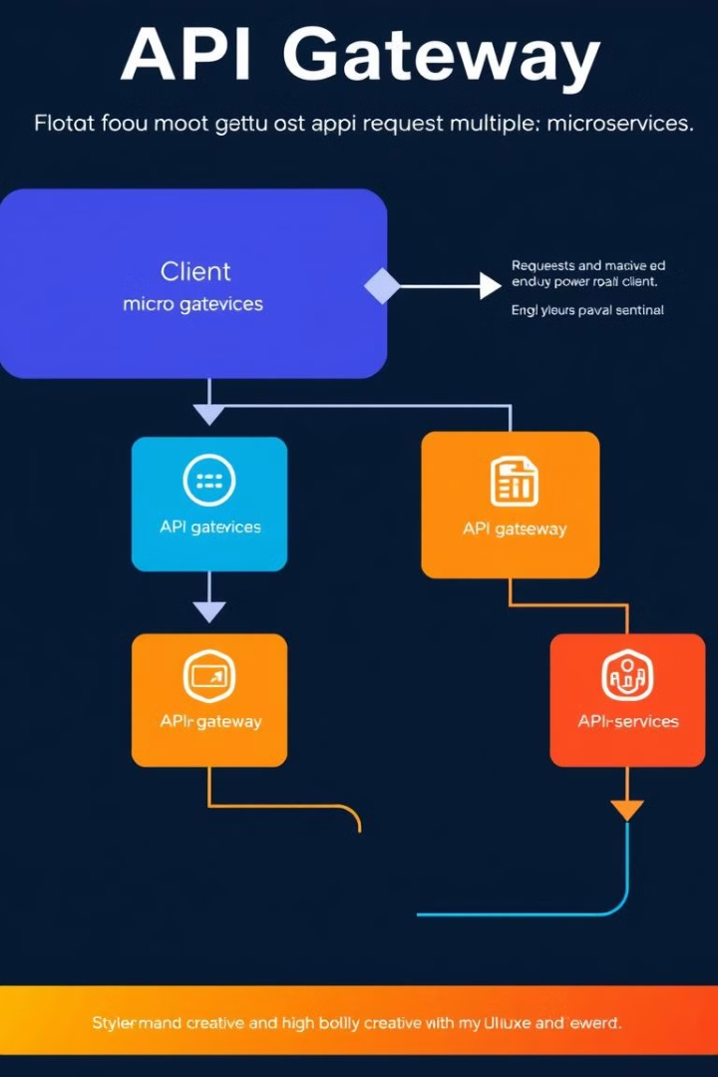




API Gateway and Data Flow
API Gateway
Spring Cloud Gateway sets up routing rules to forward requests to appropriate microservices.
Authentication
User logs in through User Management service and receives a JWT token.
Authorization
JWT token is attached to requests to ensure only authenticated users can access or modify documents.
Real-time Editing
WebSocket provides real-time collaborative editing, broadcasting changes to all users viewing the document.

Slide 8
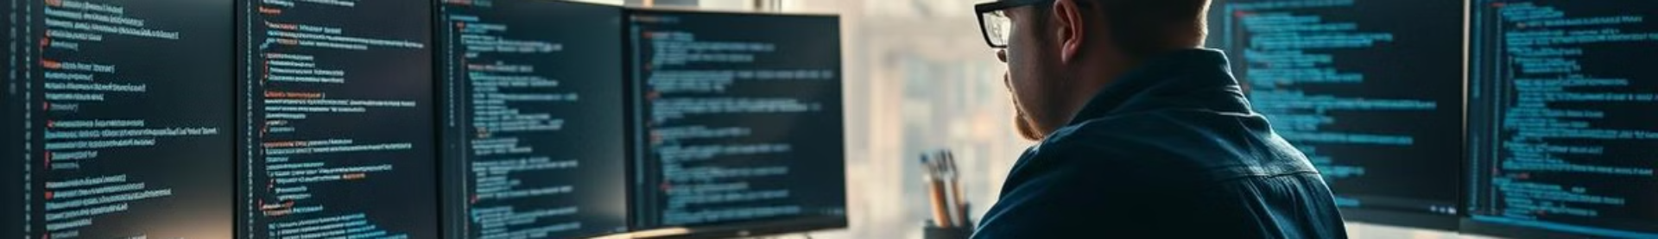
Implementation Steps
1
Setup Project Structure
Create separate Spring Boot applications for each microservice and set up Spring Cloud Gateway.
2
Develop Microservices
Implement endpoints for each service with necessary functionalities.
3
Configure API Gateway
Set up Spring Cloud Gateway routes to direct requests to appropriate microservices.
4
Swagger Integration and Testing
Add Swagger for API documentation and implement JUnit tests for each operation and integration.

Slide 9
Real-Time Editing Feature
WebSocket Implementation
Broadcast Updates
Conflict Resolution
Implement a system to broadcast updates to all users viewing the document. This ensures that changes made by one user are immediately visible to others, facilitating true real-time collaboration.
Develop a robust conflict resolution mechanism to handle simultaneous edits from multiple users, ensuring data consistency and a smooth user experience.
Use WebSocket in the Document Editing service to support live collaboration. This allows for real-time updates and seamless interaction between users working on the same document.

